Slide 1
Quantum CNN
12-6-2021

Slide 2
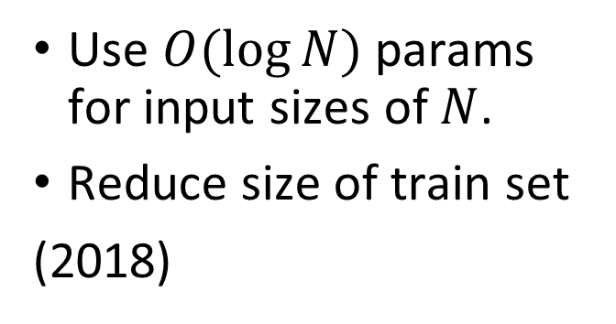
1. Intro
Pure Quantum CNN
Use to solve real physical probelsm:
Quantum many – body
Quantum error – correction
Hybrid Quantum – Clasical CNN
Replace convolutional layer by quantum convolutional layer
Quanvolutional neural network
Use $O(\log{N)}$ params for input sizes of $N$.
Reduce size of train set
(2018)
Only convolutional layer quantum (2019)

Slide 3
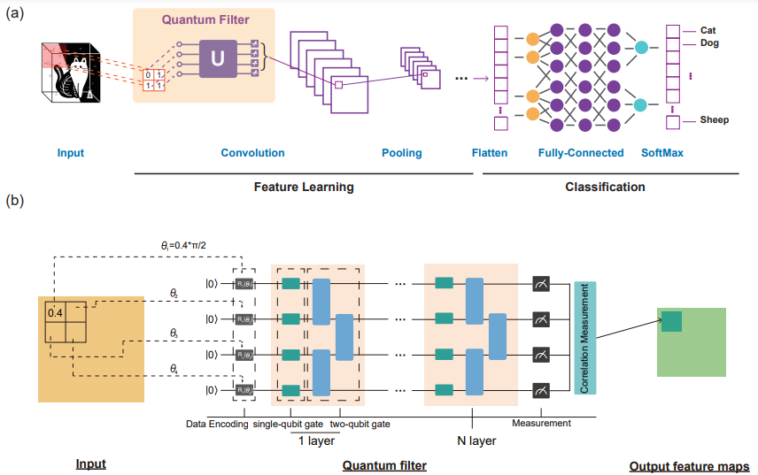

Slide 4
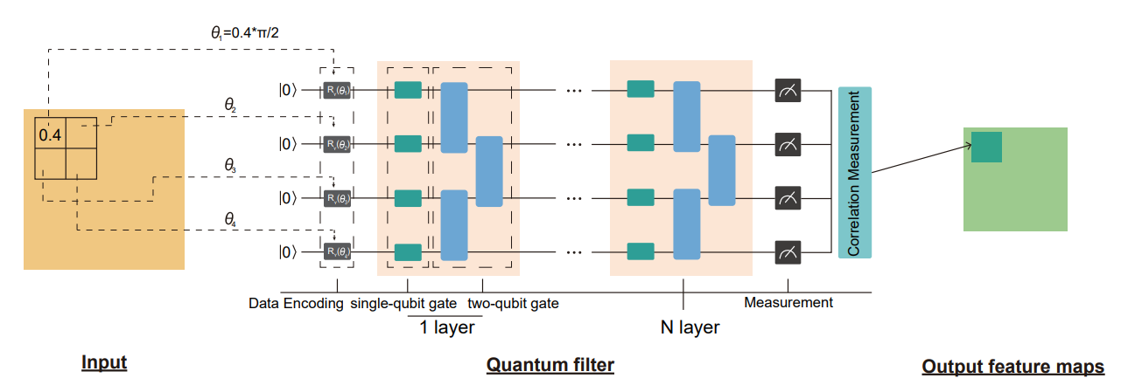
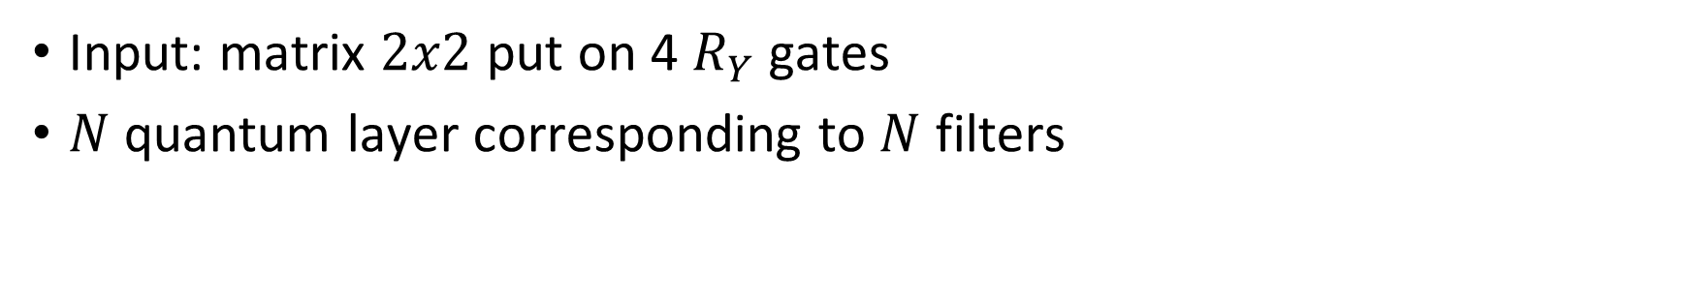
Input: matrix $2x2$ put on 4 $R_{Y}$ gates
$N$ quantum layer corresponding to $N$ filters

Slide 5



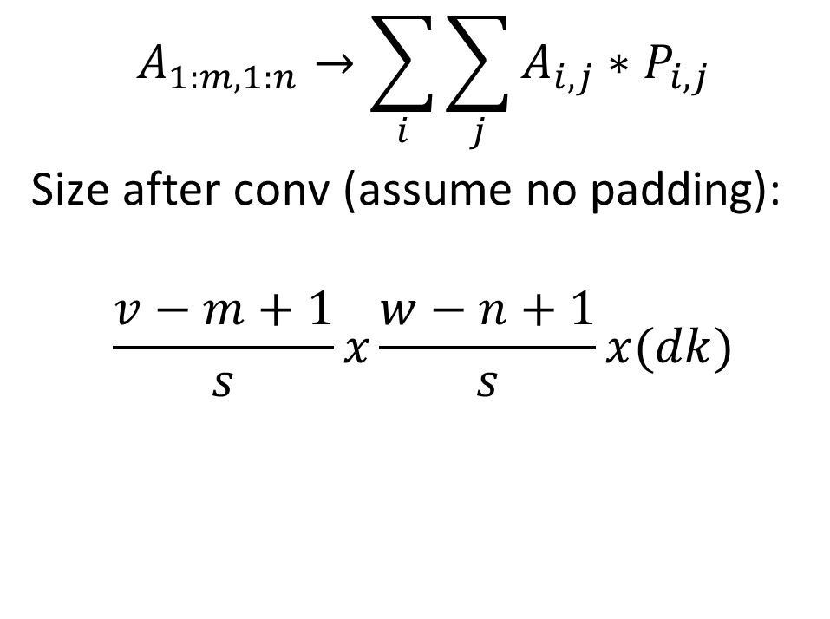





2. Quantum Convolutional
$$A_{1:m,1:n}→\sum_{i}{\sum_{j}{A_{i,j}∗P_{i,j}}}$$
Size after conv (assume no padding):
$$\frac{v−m+1}{s}x\frac{w−n+1}{s}x(dk)$$
$$n$$
Filter $P$
$$k$$
$$w$$
$$m$$
$$A$$
$$d$$
$$v$$

Slide 6
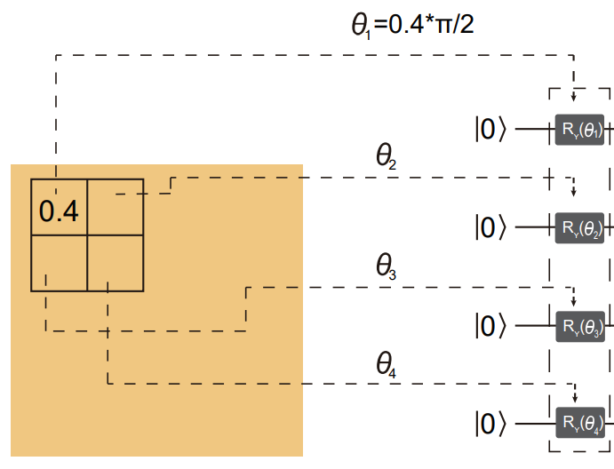
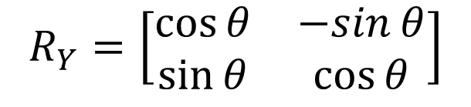

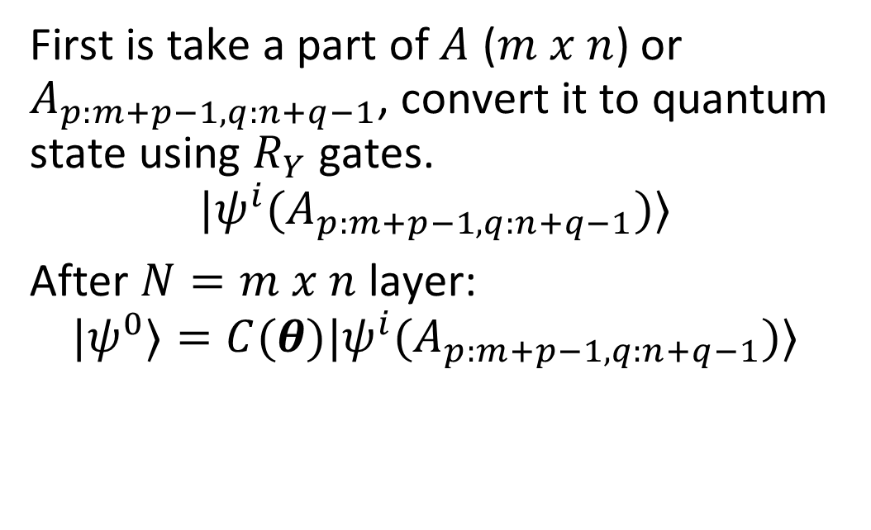



2. Quantum Convolutional
$$n$$
$$w$$
$$m$$
First is take a part of $A$ ($m x n$) or $A_{p:m+p−1,q:n+q−1}$, convert it to quantum state using $R_{Y}$ gates.
$$|ψ^{i}(A_{p:m+p−1,q:n+q−1})⟩$$
After $N=m x n$ layer:
$${|ψ}^{0}⟩=C(θ)|ψ^{i}(A_{p:m+p−1,q:n+q−1})⟩$$
$$v$$
$$R_{Y}=\left[\begin{matrix}\cos{θ} & −sin{θ} \\ \sin{θ} & \cos{θ}\end{matrix}\right]$$

Slide 7
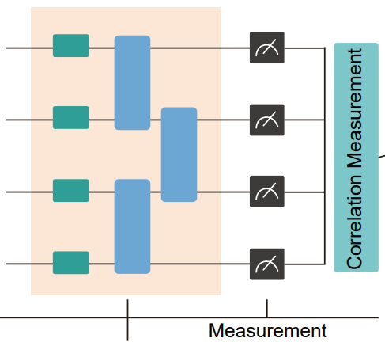

2. Quantum Convolutional
Final step is measure in observable $Z^{⊗N}.$
The quantum filter is map from:
$$A_{p:m+p−1,q:n+q−1}→⟨ψ^{0}\left|Z^{⊗N}\right|ψ^{0}⟩$$

Slide 8
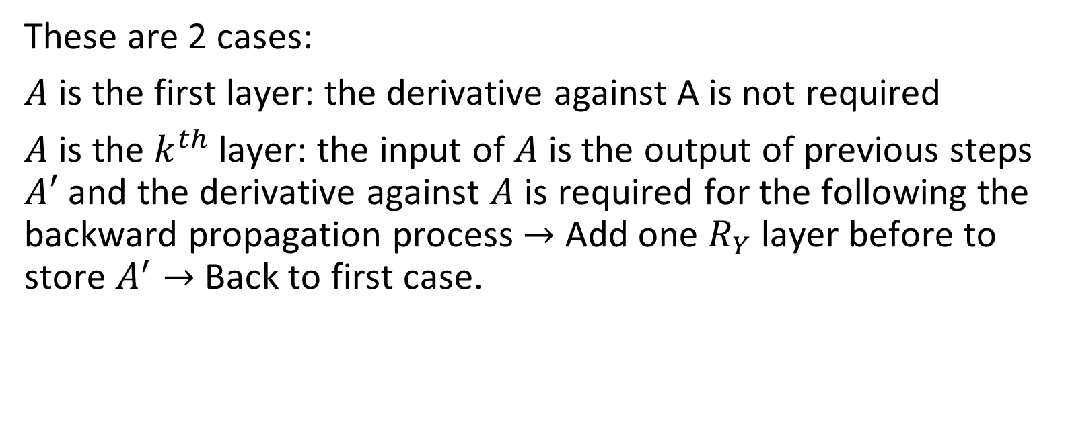
3. Gradient on Quantum Convolutional
These are 2 cases:
$A$ is the first layer: the derivative against A is not required
$A$ is the $k^{th}$ layer: the input of $A$ is the output of previous steps $A′$ and the derivative against $A$ is required for the following the backward propagation process $→$ Add one $R_{Y}$ layer before to store $A^{′}→$ Back to first case.

Slide 9
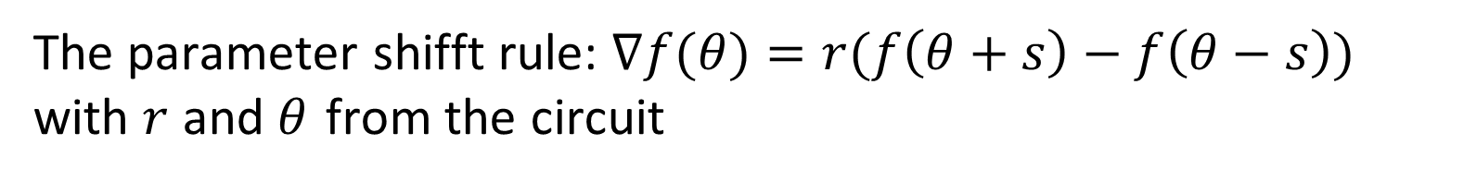
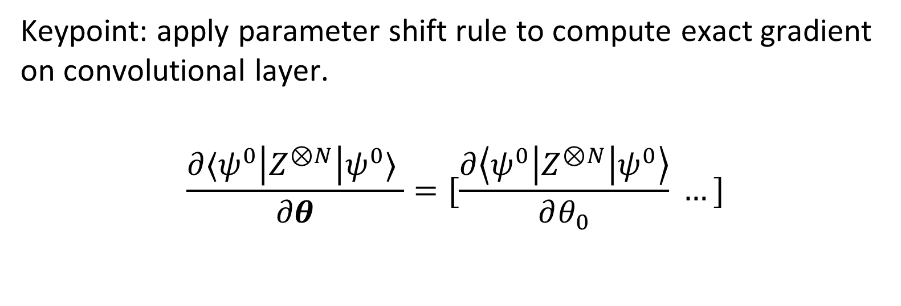
3. Gradient on Quantum Convolutional
Keypoint: apply parameter shift rule to compute exact gradient on convolutional layer.
$$\frac{∂⟨ψ^{0}\left|Z^{⊗N}\right|ψ^{0}⟩ }{∂θ}=[\frac{∂\left\langle ψ^{0}\left|Z^{⊗N}\right|ψ^{0}\right\rangle }{∂θ_{0}} …]$$
The parameter shifft rule: $∇f(θ)=r(f\left(θ+s\right)−f\left(θ−s\right))$ with $r$ and $θ$ from the circuit

Slide 10
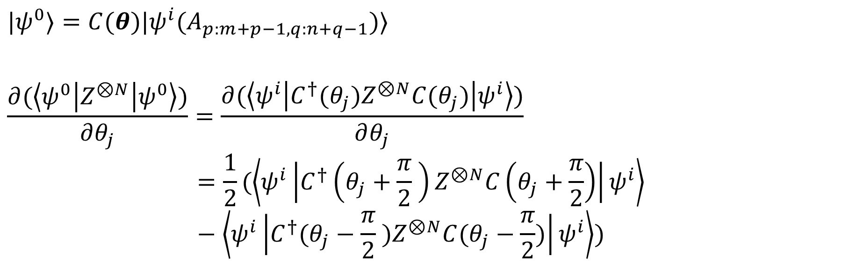
3. Gradient on Quantum Convolutional
$${|ψ}^{0}⟩=C(θ)|ψ^{i}(A_{p:m+p−1,q:n+q−1})⟩$$
$$\frac{∂(\left\langle ψ^{0}\left|Z^{⊗N}\right|ψ^{0}\right\rangle )}{∂θ_{j}}=\frac{∂(\left\langle ψ^{i}\left|C^{†}(θ_{j})Z^{⊗N}C(θ_{j})\right|ψ^{i}\right\rangle )}{∂θ_{j}}$$
$$=\frac{1}{2}(\left\langle ψ^{i}\left|C^{†}\left(θ_{j}+\frac{π}{2} \right)Z^{⊗N}C\left(θ_{j}+\frac{π}{2}\right)\right|ψ^{i}\right\rangle −\left\langle ψ^{i}\left|C^{†}(θ_{j}−\frac{π}{2} )Z^{⊗N}C(θ_{j}−\frac{π}{2})\right|ψ^{i}\right\rangle )$$
The parameter shifft rule: $∇f(θ)=r(f\left(θ+s\right)−f\left(θ−s\right))$ with $r$ and $θ$ from the circuit

Slide 11
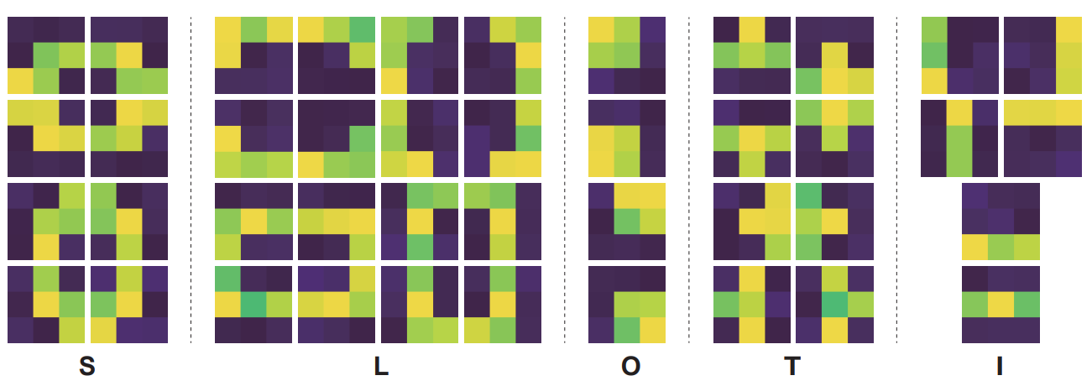
4. Experiments
Tetris dataset: 1000 gray 3x3 images, foreground 0.7$→$1, background $0→0.1$

Slide 12
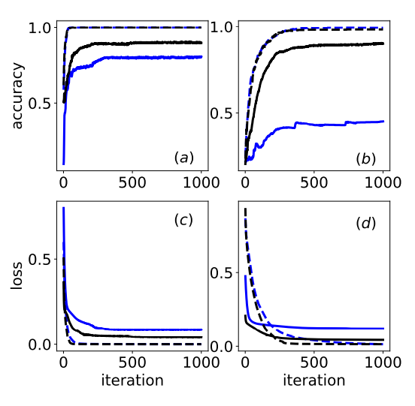
4. Experiments
Blue line: one-layer CNN
Black line: two-layer CNN
Blue dashed line: one-layer QCCNN
Black dashed line: two-layer QCCNN
Accuracy in case of 2 labels.
Accuracy in case of 5 labels.
(c) Loss in case of 2 labels.
(d) Loss in case of 5 labels
Setting:
Optimizer ADAM
Learning rate of 0.01.
The results are averaged over 10 random simulations.
Train/set: 8/2
One layer: 5 filter
Two layer: 2 & 3 filter, window: 2x2, s=1

